Slide 1
‘How-to use’ Guide
Using Local Insight

Slide 2
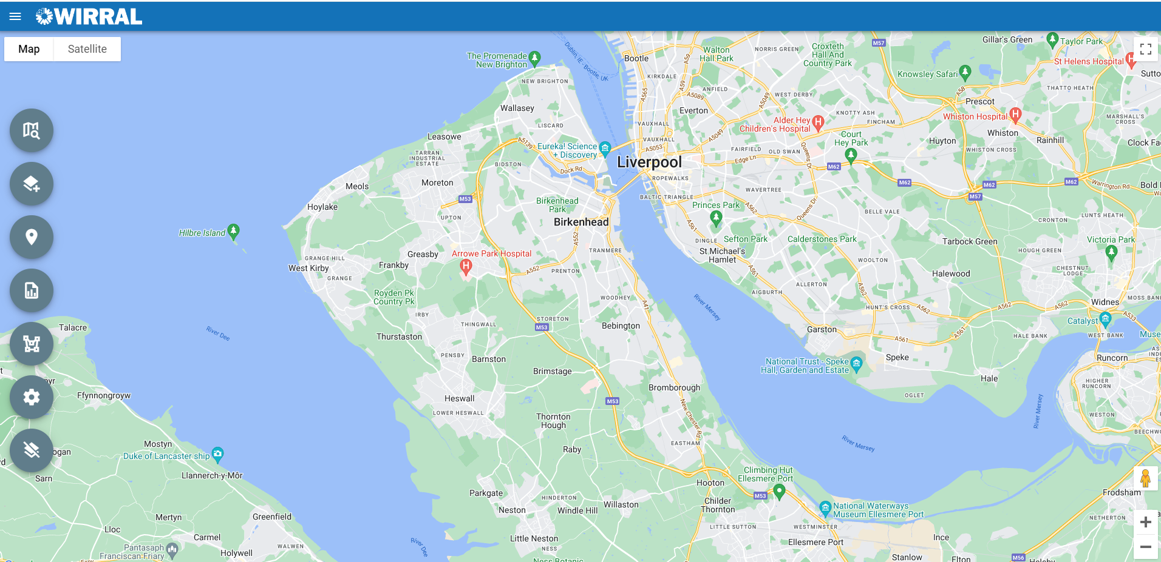
URL: wirral.localinsight.org
This is what will open on your screen when you type in the web address
Navigate
Data
Services
Reports
Custom Areas
Settings
Clear Map
Zoom

Slide 3
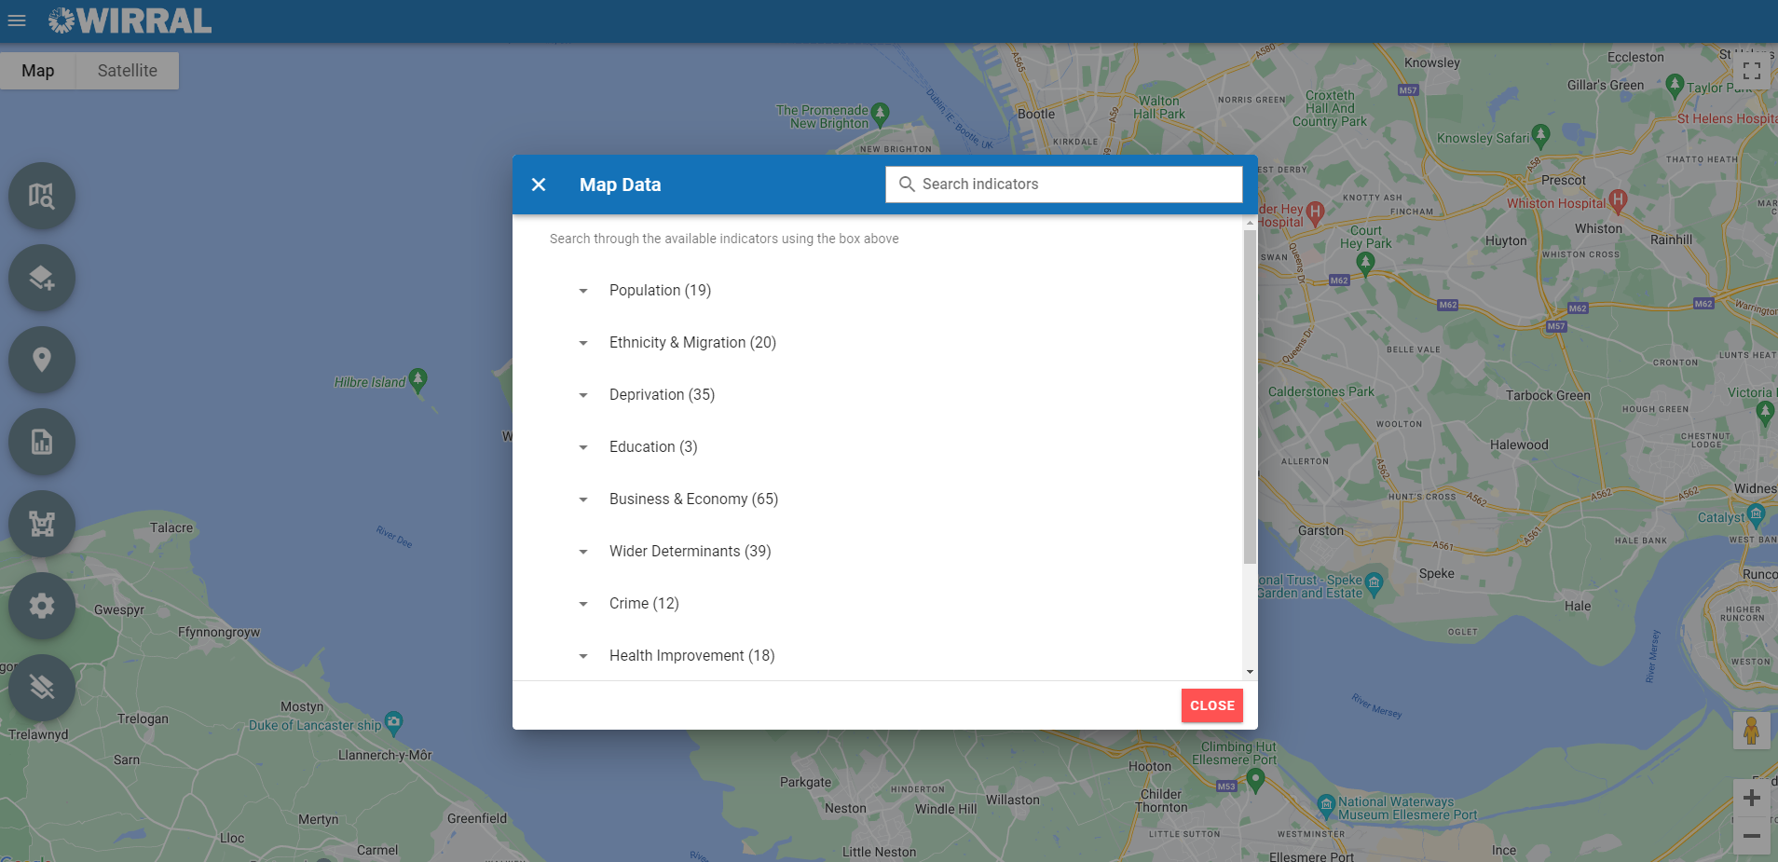
Data
Data indicators are arranged into themes
Pick any theme and a list of corresponding indicators will appear, (e.g. select ‘Deprivation’ and scroll down to select ‘Index of Multiple Deprivation 2019 (IMD) Score’)

Slide 4
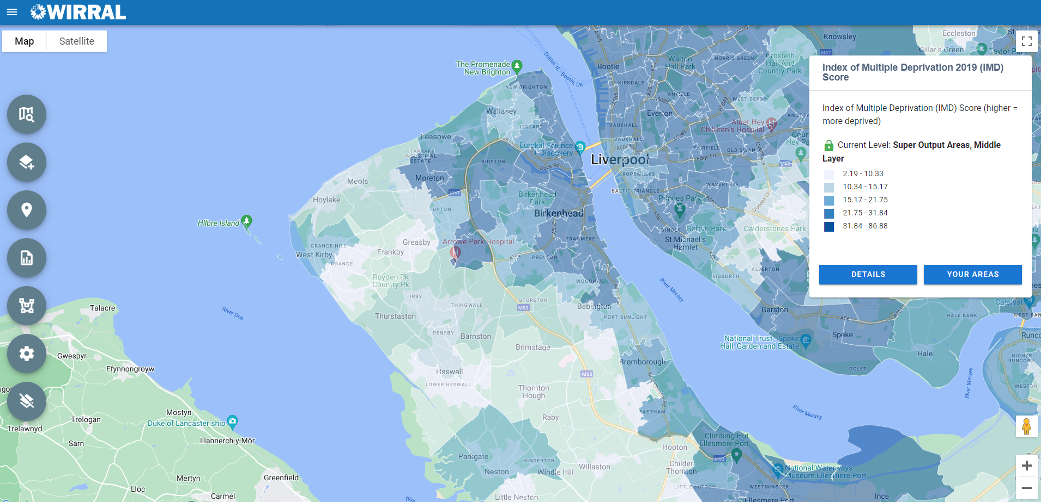
Data
Click on the indicator name to show the legend
Notice how the map of Wirral becomes shaded with your chosen indicator
You can lock the level of geography you’re viewing an indicator at by selecting the green lock button in the legend (circled in red above)
For the definition of the indicator, click ‘Details’

Slide 5
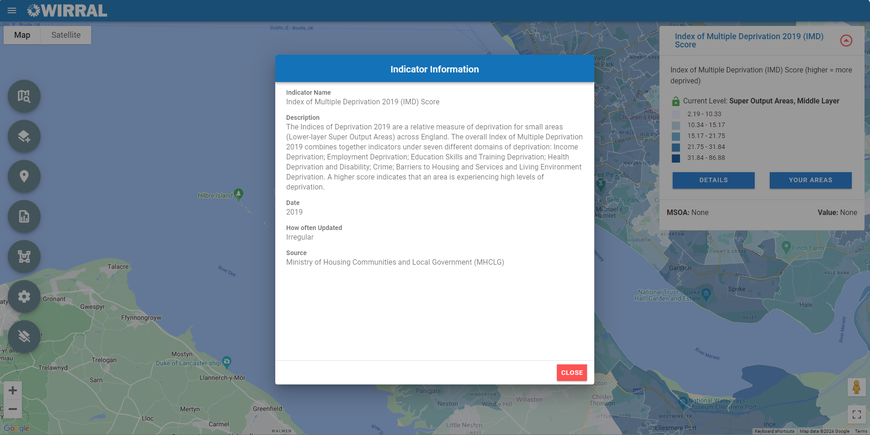
Data
If you are ever unsure about what an indicator means, how old it is, or the source of the data, clicking the ‘Details’ button will return a pop-up box giving more information (e.g. IMD score was produced by MHCLG in 2019)

Slide 6
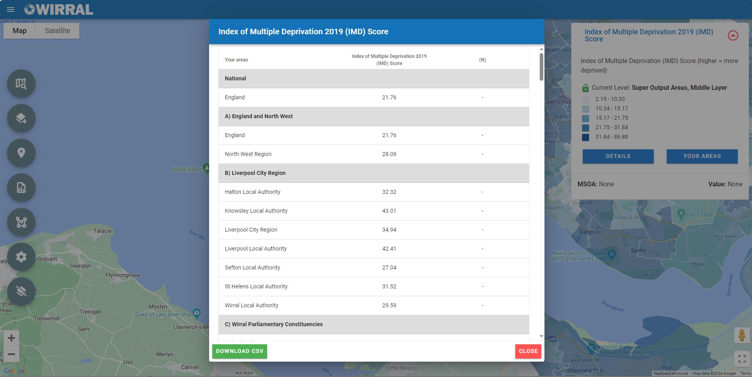
Data
Clicking on ‘Your Areas’ shows the values of that particular indicator for all areas (e.g. Wards, Constituencies, Healthy High Street areas, etc.).
If you want to download these figures (in a CSV) click on the ‘Download CSV’ button

Slide 7
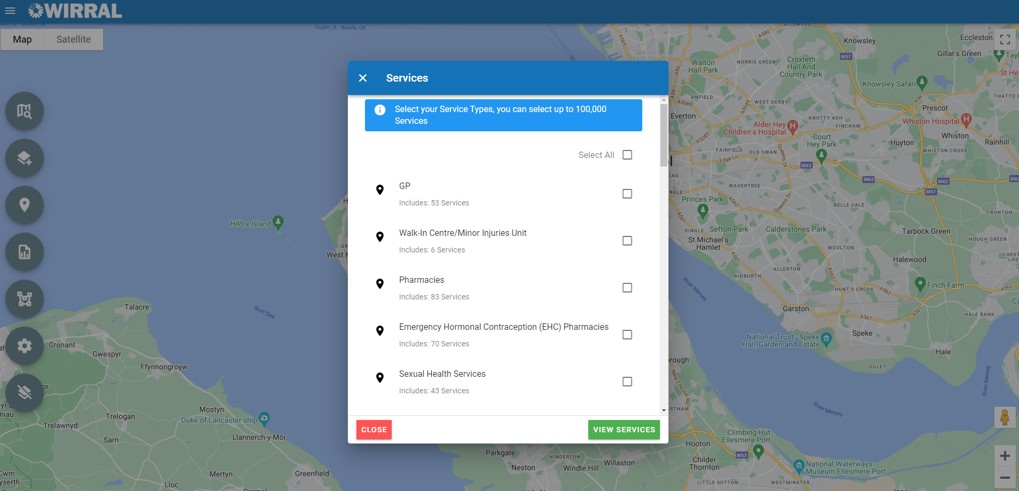
Services
You can show the location of services over any data indicator
Click on the services and select the service you want to appear on the map by ticking the respective box
If you want services ONLY in a particular area to be shown, select ‘Areas’ first

Slide 8
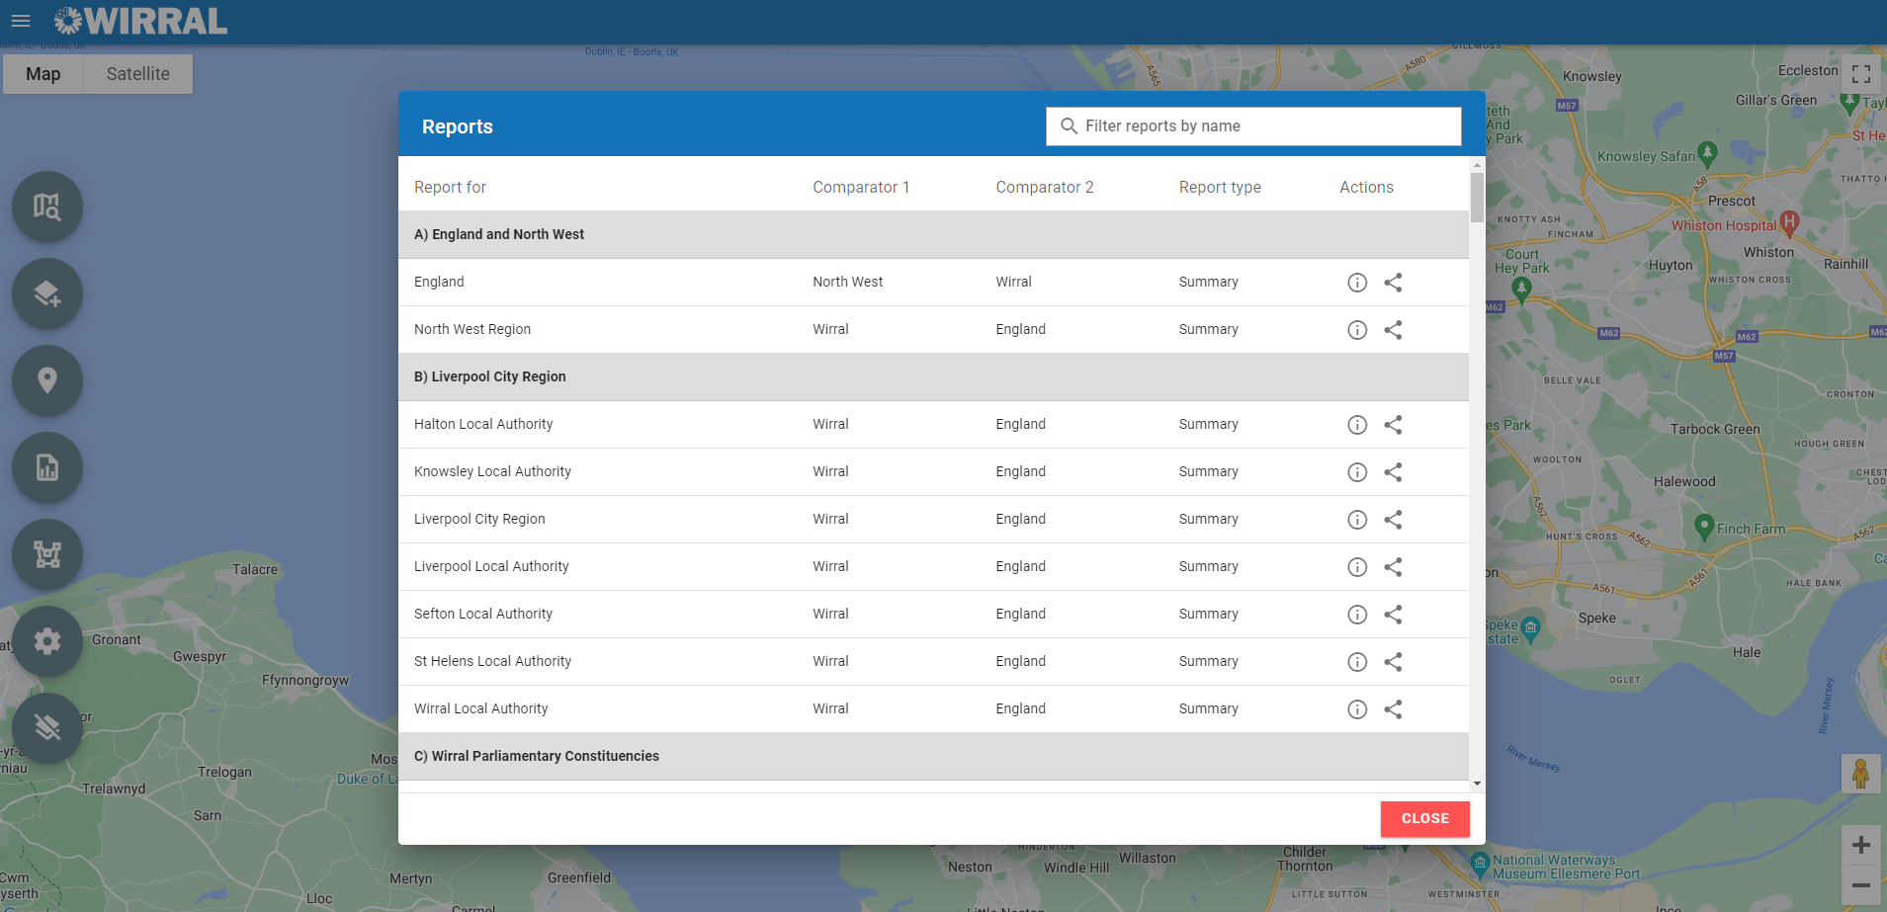
Reports
Summary reports are available for all areas (Wards, Constituencies, Healthy High Streets) and are fully accessible
If you want a custom report about a particular theme for a specific area (e.g. Income and Employment for Bebington Ward), please get in touch as we can create now bespoke reports

Slide 9
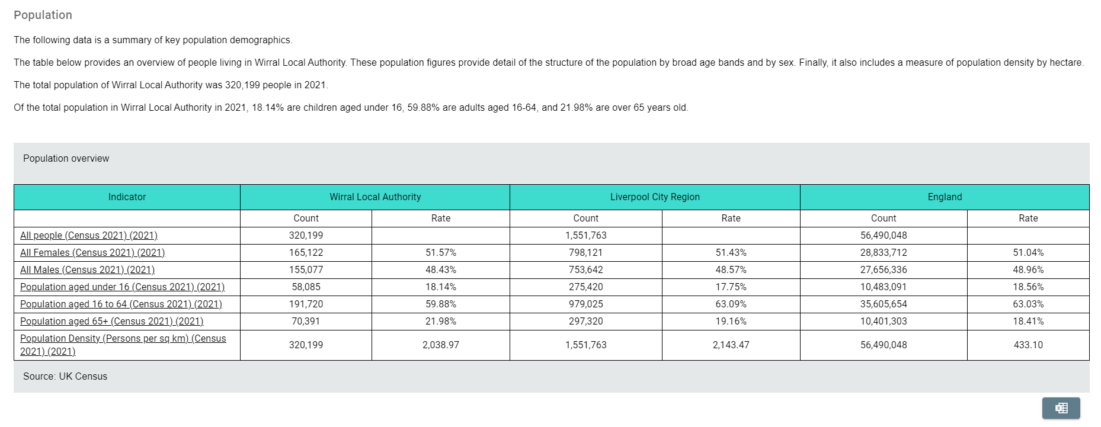
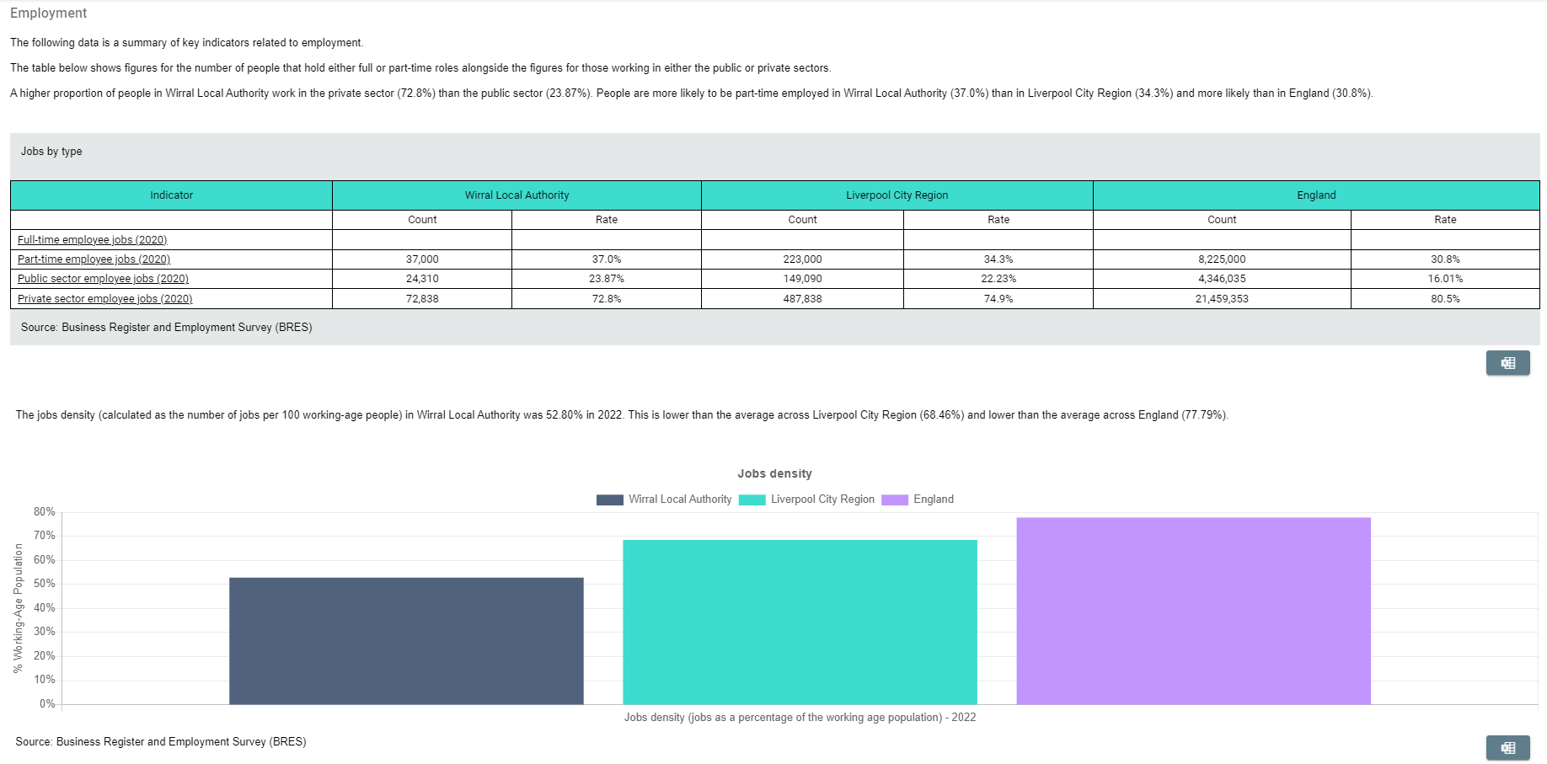
Reports

Slide 10
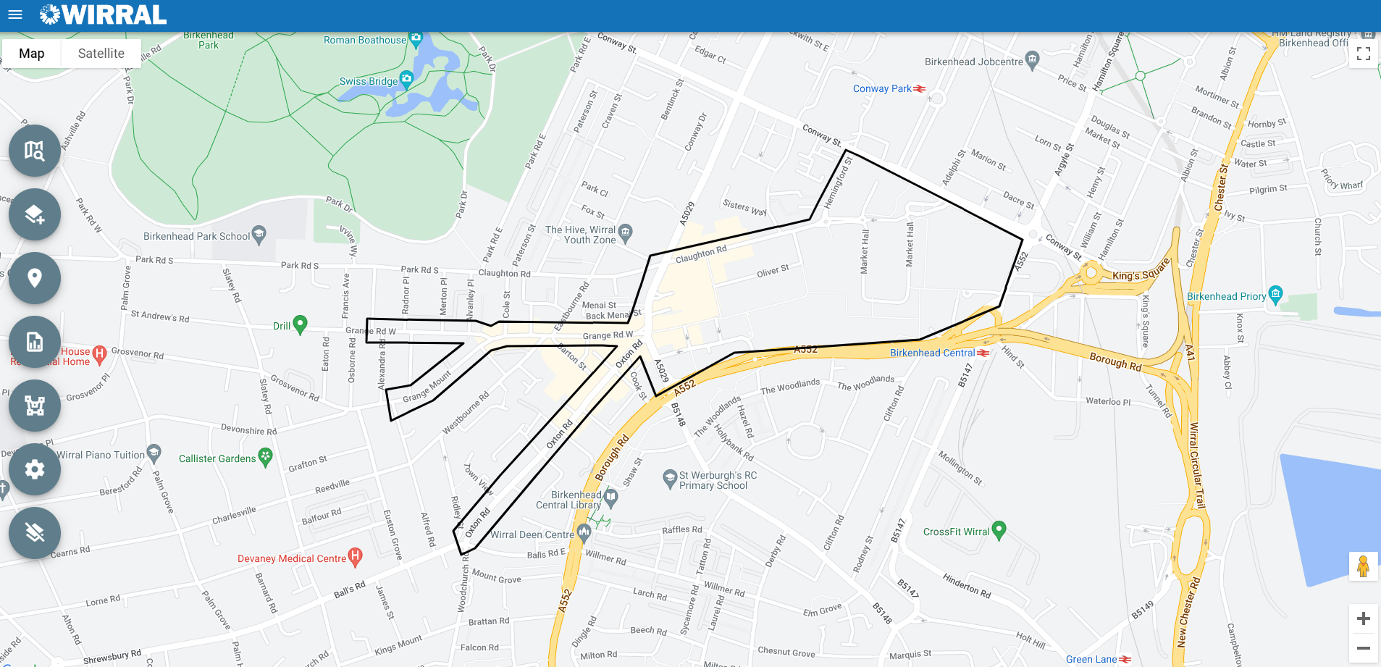
Areas
Areas
Select any area from the list and that area will appear on the map. Any services previously selected will now only appear within that area
This bespoke area was set up to make a case for a Cumulative Impact Policy for Alcohol (boundary decided on by Merseyside Police & MBW Licensing Team); ordinarily, this would be very difficult to obtain information on this area (not a standard area, crossed several LSOAs), but in Local Insight, this was a more straightforward process. A bespoke area aggregates the data to best fit

Slide 11
Getting maps for your reports
Click on the ‘Snip and Sketch’ button (shown above) within the taskbar in the bottom left of the computer screen
Use the cross-shaped cursor to ‘snip’ around the map. You can then save it (by clicking on ‘File’ and then ‘Save As’

Slide 12
…but I can’t see???
Want an area or indicator that you can’t see currently?
Contact us: phintelligence@wirral.gov.uk
We can create any bespoke area you need, such as estates that don’t fit neatly to wards – you will then be able to view reports, maps, etc… just for that estate or area
We can also upload Wirral data to Local Insight. So data from a commissioned service for example, could be uploaded if you would find it useful
For data to be uploaded, it must be available at postcode or LSOA level and cannot be person identifiable data (in line with the Data Protection Act 2018), as Local Insight is a web-based tool available to the public
Public Health Intelligence Team

